Slide 1


Rahul Rathore
13th August, 2022

Slide 2

Outline
Executive Summary
Introduction
Methodology
Results
Conclusion

Slide 3
Executive Summary
This project help predicting if the SpaceX Falcon 9 first stage will land successfully using several machine learning algorithms.
The project includes various steps as mentioned below:
• Data collection, wrangling, and formatting
• Exploratory data analysis
• Interactive data visualization
• Machine learning prediction
Visualizations shows how landing outcome is correlated to the location of launch sites, payload mass and various other factors
We found that almost all classification models have similar out of sample accuracy, however Decision Trees model also reflect high training accuracy.

Slide 4
Introduction
SpaceX advertises Falcon 9 rocket launches on its website with a cost of 62 million dollars; other providers cost upward of 165 million dollars each, much of the savings is because SpaceX can reuse the first stage. Therefore if we can determine if the first stage will land, we can determine the cost of a launch.
We want to know correlation of outcome of launch on certain factors, so that we can find the more favorable outcome basis the factors, like Launch site, Payload mass, Booster version, etc.

Slide 5


Slide 6
Methodology
Data collection methodology:
Data is collected using Request to the SpaceX API and Web scrapping Falcon 9 Wikipedia web page.
Perform data wrangling
Data is wrangled using python’s pandas and numpy libraries.
Perform exploratory data analysis (EDA) using visualization and SQL
Perform interactive visual analytics using Folium and Plotly Dash
Perform predictive analysis using classification models
Whole data is standardized and then split into train and test data for the evaluation, the best hyperparameters are determined using GridSearchCV class and evaluated using score method.

Slide 7
Data Collection – SpaceX API
The API endpoint is https://api.spacexdata.com/v4/launches/past
The whole data is converted in json and then into dataframe using pandas json_normalize method.
More api calls were made to get the values of booster version, launch site, payload mass and more.
All the information is stored in launch_dict variable in dictionary format and then converted into dataframe using pandas’s from_dict method.

Slide 8

Data Collection – SpaceX API
Resulted Dataframe is filtered with Falcon 9 data and missing values are replaced with the mean of column.
Final Dataframe is 90 rows × 17 columns in dimension.
Here github file link: https://github.com/rathore793/IBM_capstone_project/blob/main/data_collection_api.ipynb

Slide 9
Data Collection - Web Scraping
Data is collected using python module BeautifulSoup, it is a web scrapping module used to scrap below Wikipedia page: https://en.wikipedia.org/wiki/List_of_Falcon_9_and_Falcon_Heavy_launches
Soup object is created and various methods are applied in order to extract the required information from the web page.
launch_dict is created with the column names as keys.

Slide 10
Data Collection - Web Scraping
The dictionary is converted into dataframe using pandas.
Final Dataframe is 120 rows × 11 columns in dimension.
Here github file link: https://github.com/rathore793/IBM_capstone_project/blob/main/data_collection_web_scraping.ipynb

Slide 11
Data Wrangling
Further the data is analyzed for missing values or different data type of the columns.
Then data is analyzed basis the different launch sites, Orbits and launching outcomes.
Another column is added with name class which indicate the outcome of the launch, Success is 1 and Failure is 0.
Here github file link: https://github.com/rathore793/IBM_capstone_project/blob/main/EDA.ipynb

Slide 12
EDA with Data Visualization
Exploratory Data Analysis is performed using pandas and matplotlib.
Scatter plot is created for visualize correlation between different features and launch outcomes.
Bar plot is created to visualize the orbit relation with the success rate.
Line plot is created to visualize the change in success rate over the year.
Here’s the github link: https://github.com/rathore793/IBM_capstone_project/blob/main/EDA_with_visualization.ipynb

Slide 13
EDA with SQL
SQL is used to find the insights of the data as mentioned below:
To find the names of all different sites.
Which booster version carried the maximum payload.
What is the date of first successful launch.
Count of total number of successful and failed outcomes.
Name of Booster version and Sites with failed outcomes.
Average payload mass carried by specific booster version, etc.
Here’s Github link: https://github.com/rathore793/IBM_capstone_project/blob/main/EDA_using_SQL.ipynb

Slide 14
Build an Interactive Map with Folium
All sites are marked on the map with latitudes and longitudes with circle and marker as the name of the launch sites.
Marker cluster is created with color coding, as red showing failed outcome and green as successful.
Distance is calculated with its proximities such as coastline, railway line, city and highway, to check whether the launch sites are kept at the safe distance from proximities.
Here’s github link: https://github.com/rathore793/IBM_capstone_project/blob/main/Interactive%20Visual%20Analytics.ipynb

Slide 15
Build a Dashboard with Plotly Dash
We have created a dashboard with a dropdown menu to select the site name, range slider to select the range of payload mass, a pie chart to show success rate and scatter plot to show successful outcome basis the payload mass, booster version and name of the site.
All site data is show by default so that we can compare the success rate of all the sites.
Scatter plot helps in knowing what payload mass is having highest success rate for particular site.
Here’s the github link for its python script: https://github.com/rathore793/IBM_capstone_project/blob/main/spacex_dash_app.py

Slide 16
Predictive Analysis
Data is loaded, standardized and split into training and testing dataset.
Objects were created for Logistic Regression, Support Vector Machine, Decision Tree and K Nearest Neighbor.
Parameter variable also created for each method to find the best parameters.
GridSearchCV object is created with parameter as method object, their parameter and CV.

Slide 17
Predictive Analysis
GridSearchCV object is fitted with training input and output.
Best Parameters are found using best_params_ method.
Accuracy is checked using score method.
Confusion matrix function is also created to visualize it for each classification method.
Basis the training and testing accuracy best model is found.
Here’s the link for github: https://github.com/rathore793/IBM_capstone_project/blob/main/predictive_analysis.ipynb

Slide 18
Results
The Project have various results basis SQL, visualization, folium, dash and predictive analysis, we will show each results in upcoming sections under below titles:
Insights drawn from EDA
Launch Sites proximities analysis
Build Dashboard with plotly dash
Predictive Analysis

Slide 19

Section 2

Slide 20
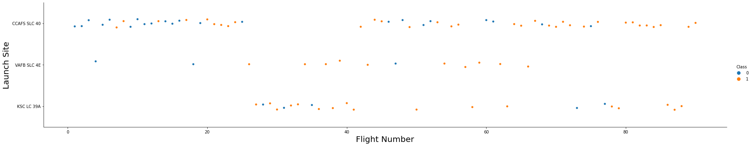
Flight Number vs. Launch Site
The Relation between Flight Number and Launch Site shows that with increase in number of flight number the rate of success also increased.
VAFB SLC 4E have lowest number of flight number but the success rate is high.

Slide 21
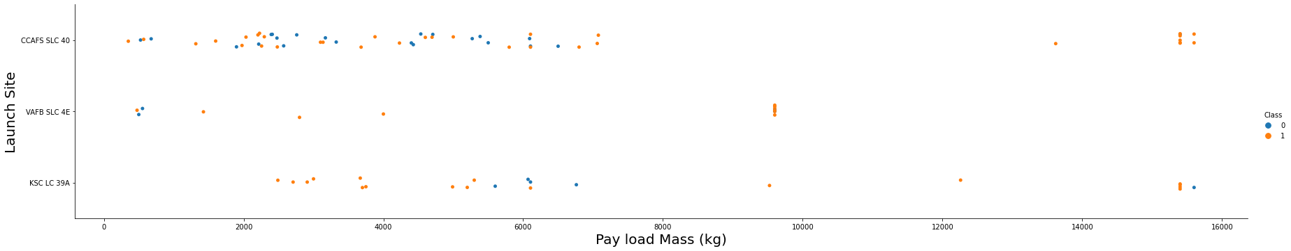
Payload vs. Launch Site
The relation between Payload and Launch Site is shown below.
Site CCAFS SLC 40 shows for payload mass greater than 14000kg the success rate is 100%.
Site KSC LC 39A shows for payload mass less than 5000kg the success rate is 100%.
Site VAFB SLC 4E shows for payload between 8-10000 kg the success rate is 100%.

Slide 22
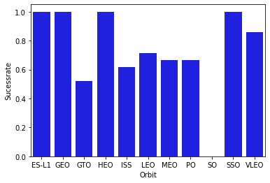
Success Rate vs. Orbit Type
The Relationship shows that for the Orbit ES-L1, GEO, HEO and SSO the Success rate is 100%
LEO and VLEO have Success rate between 70-80%.
Rest all have success rate between 50 and 60%.

Slide 23
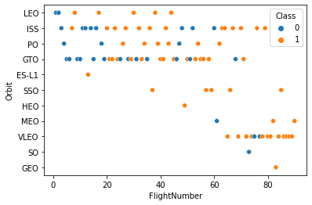
Flight Number vs. Orbit Type
LEO shows that with increase in flight number the success rate is increasing.
GEO do not have any relationship with Flight Number

Slide 24
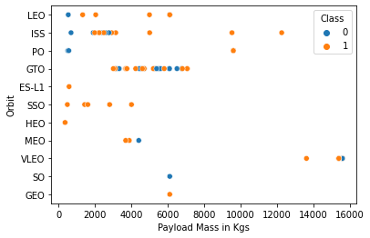
Payload vs. Orbit Type
With heavy payloads the successful landing or positive landing rate are more for Polar, LEO and ISS

Slide 25
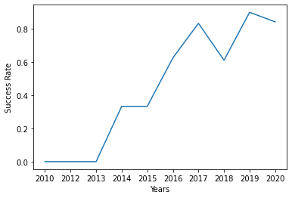
Launch Success Yearly Trend
With the help of screenshot we can verify that after year 2013 the success rate of launch is gradually increasing.

Slide 26
All Launch Site Names
launch_site
CCAFS LC-40
CCAFS SLC-40
KSC LC-39A
VAFB SLC-4E
Query to find all distinct launch sites is given below:
%SQL SELECT DISTINCT LAUNCH_SITE FROM SPACEXTBL
There are five 5 distinct launch sites

Slide 27
Launch Site Names Begin with 'CCA'
Query to find all launch sites begin with ‘CCA’ is given below:
%SQL SELECT * FROM SPACEXTBL WHERE LAUNCH_SITE LIKE 'CCA%' LIMIT 5
DATE | time__utc_ | booster_version | launch_site | payload | payload_mass__kg_ | orbit | customer | mission_outcome | landing__outcome
2010-06-04 | 18:45:00 | F9 v1.0 B0003 | CCAFS LC-40 | Dragon Spacecraft Qualification Unit | 0 | LEO | SpaceX | Success | Failure (parachute)
2010-12-08 | 15:43:00 | F9 v1.0 B0004 | CCAFS LC-40 | Dragon demo flight C1, two CubeSats, barrel of Brouere cheese | 0 | LEO (ISS) | NASA (COTS) NRO | Success | Failure (parachute)
2012-05-22 | 07:44:00 | F9 v1.0 B0005 | CCAFS LC-40 | Dragon demo flight C2 | 525 | LEO (ISS) | NASA (COTS) | Success | No attempt
2012-10-08 | 00:35:00 | F9 v1.0 B0006 | CCAFS LC-40 | SpaceX CRS-1 | 500 | LEO (ISS) | NASA (CRS) | Success | No attempt
2013-03-01 | 15:10:00 | F9 v1.0 B0007 | CCAFS LC-40 | SpaceX CRS-2 | 677 | LEO (ISS) | NASA (CRS) | Success | No attempt

Slide 28
Total Payload Mass
Query to find Total Payload mass carried by NASA is below:
%SQL SELECT SUM(payload_mass__kg_) AS total_mass FROM SPACEXTBL WHERE payload LIKE '%CRS%'
Total Mass carried by NASA payload is 111268 kgs
total_mass
111268

Slide 29
Average Payload Mass by F9 v1.1
Query to find the average payload mass carried by booster version F9 v1.1 is below:
%SQL SELECT AVG(PAYLOAD_MASS__KG_) AS AVERAG_PAYLOAD_MASS FROM SPACEXTBL WHERE BOOSTER_VERSION = 'F9 V1.1‘
Average Payload mass carried by booster version F9 v1.1 is 2928 kg.
averag_payload_mass
2928

Slide 30
First Successful Ground Landing Date
Query to find the first successful landing outcome on ground pad is given below:
%SQL SELECT MIN(DATE) FROM SPACEXTBL WHERE LANDING__OUTCOME = 'SUCCESS (GROUND PAD)‘
Date of first Successful landing outcome is 22th December, 2015.
1
2015-12-22

Slide 31
Successful Drone Ship Landing with Payload between 4000 and 6000
List Query to find the names of boosters which have successfully landed on drone ship and had payload mass greater than 4000 but less than 6000 is given below:
%sql select booster_version from SPACEXTBL where landing__outcome = 'Success (drone ship)' and payload_mass__kg_ between 4001 and 5999
booster_version
F9 FT B1022
F9 FT B1026
F9 FT B1021.2
F9 FT B1031.2

Slide 32
Total Number of Successful and Failure Mission Outcomes
Query to find the total number of successful and failure mission outcomes is given below:
%sql select count(mission_outcome), mission_outcome from SPACEXTBL group by mission_outcome
1 | mission_outcome
1 | Failure (in flight)
99 | Success
1 | Success (payload status unclear)

Slide 33
Boosters Carried Maximum Payload
Query to find the names of the booster which have carried the maximum payload mass is given below:
%sql select booster_version from SPACEXTBL where payload_mass__kg_ = (select max(payload_mass__kg_) from SPACEXTBL)
booster_version
F9 B5 B1048.4
F9 B5 B1049.4
F9 B5 B1051.3
F9 B5 B1056.4
F9 B5 B1048.5
F9 B5 B1051.4
F9 B5 B1049.5
F9 B5 B1060.2
F9 B5 B1058.3
F9 B5 B1051.6
F9 B5 B1060.3
F9 B5 B1049.7

Slide 34
2015 Launch Records
Query to find the failed landing_outcomes in drone ship, their booster versions, and launch site names for in year 2015 is given below:
%sql select booster_version, launch_site from SPACEXTBL where landing__outcome ='Failure (drone ship)' and year(DATE) = 2015
booster_version | launch_site
F9 v1.1 B1012 | CCAFS LC-40
F9 v1.1 B1015 | CCAFS LC-40

Slide 35
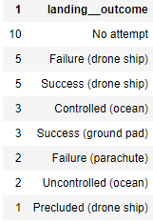
Rank Landing Outcomes Between 2010-06-04 and 2017-03-20
Query to Rank the count of landing outcomes (such as Failure (drone ship) or Success (ground pad)) between the date 2010-06-04 and 2017-03-20, in descending order is given below:
%sql select count(landing__outcome), landing__outcome from SPACEXTBL where date between '2010-06-04' and '2017-03-20' group by landing__outcome order by count(landing__outcome) desc

Slide 36

Section 3

Slide 37
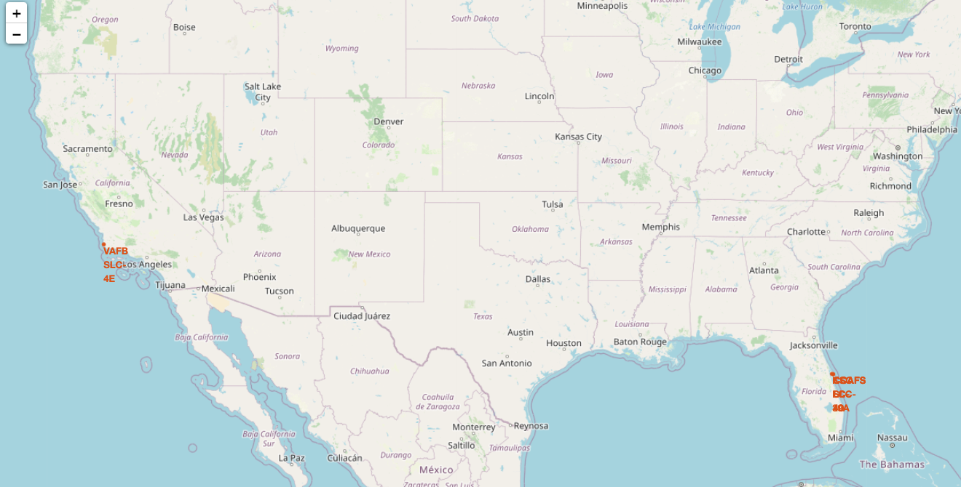
All Launch Sites on Map
3 out of 4 sites are in same state, all sites are near to coastline.

Slide 38
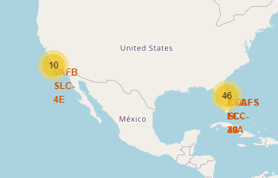
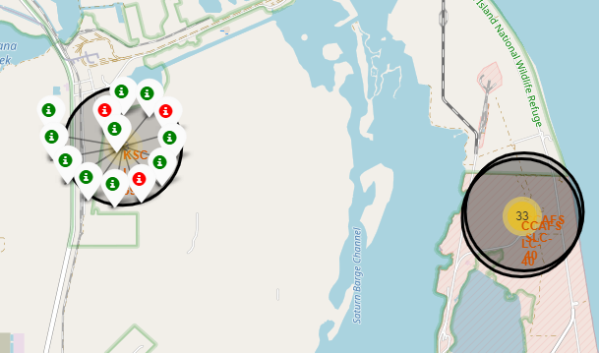
Success/Failed launches on each site on Map
Marker cluster are made of Failed and Success outcomes, where red marker mean failed and green mean successful outcome.

Slide 39
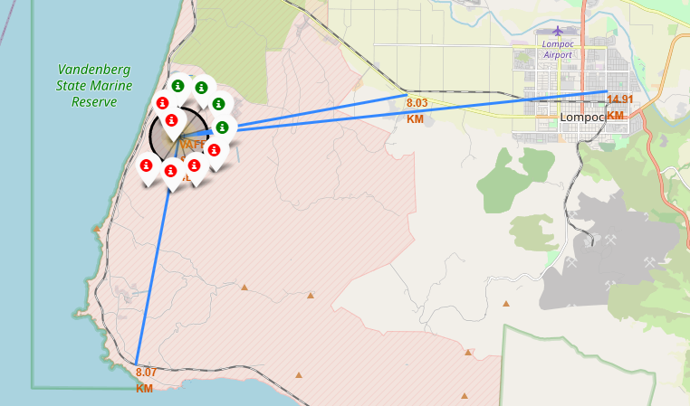
Proximities Distance from Launch Site
Distance is calculated between proximities and Launch Site and the line is drawn using Polyline.
All the Launch sites are kept at a safe distance from all the proximities.

Slide 40

Section 4

Slide 41
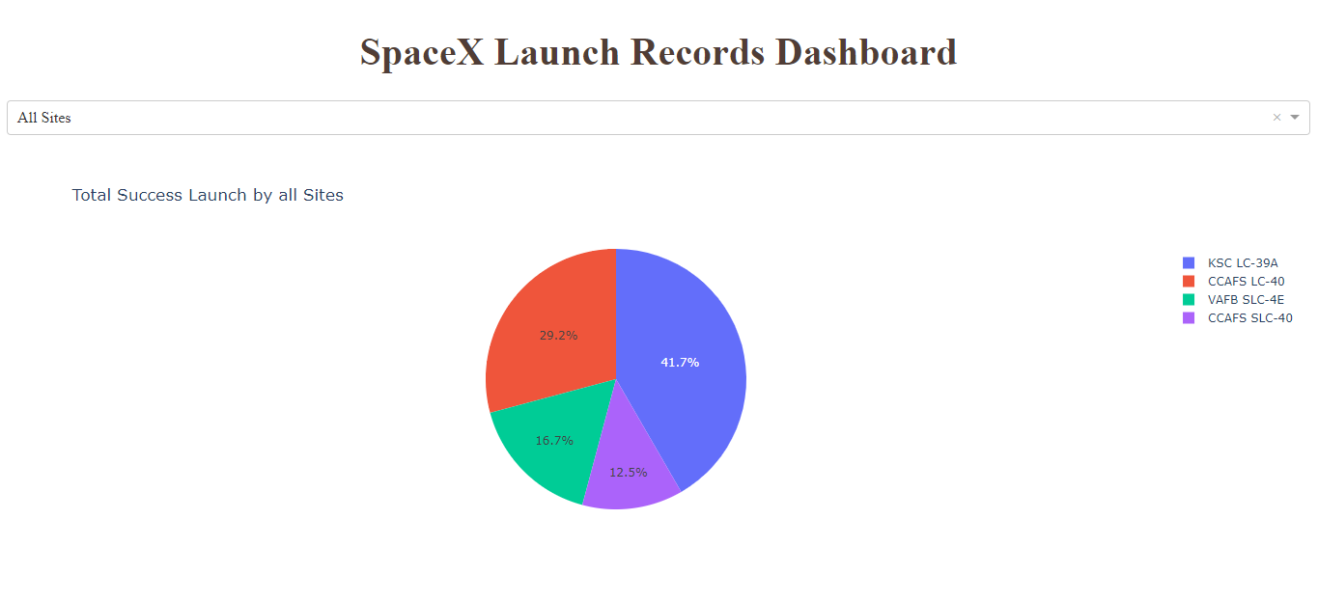
Launch Success Count for All Sites
Launch Site KSC LC 39A is having most Success count, with 41.7% Success count, followed by CCAFS SLC 40 with 29.2%, VAFB SLC 4E with 16.7%.

Slide 42
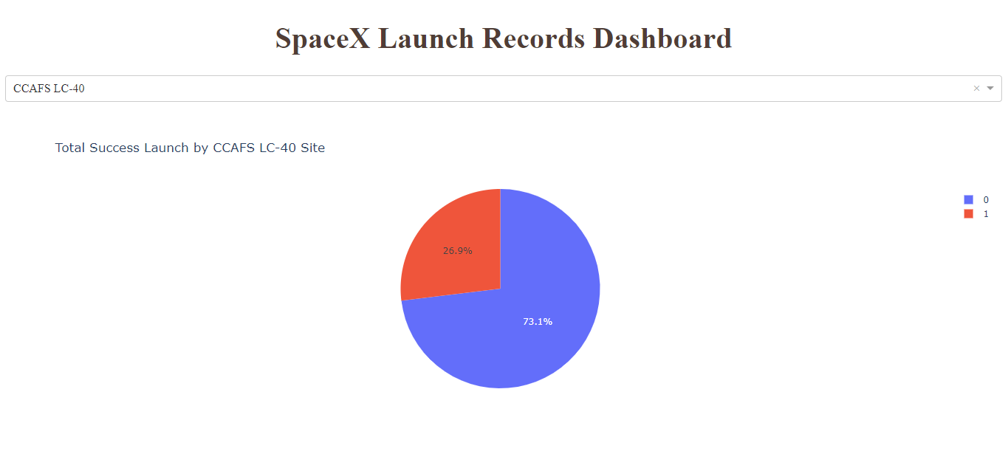
Launch Site With Highest Success Ratio
CCAFS LC-40 is having highest Success Ratio among all the other launch site with 41.7%.
The success rate of CCAFS LC-40 is only 26.9%.

Slide 43
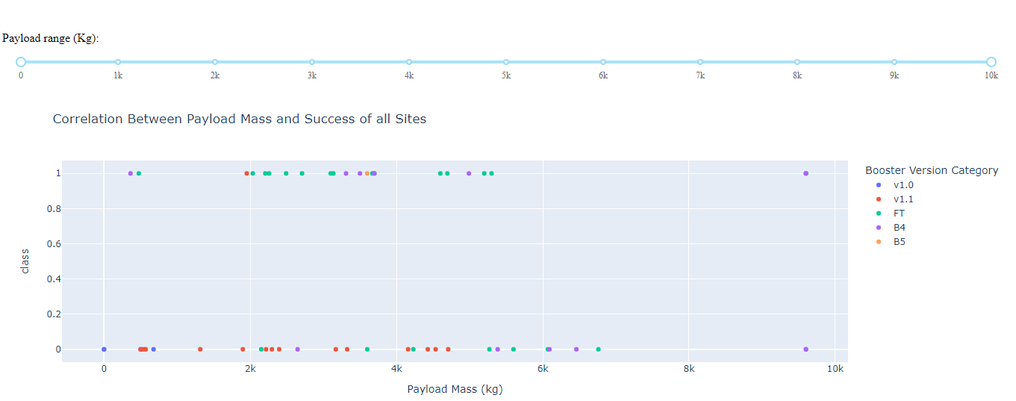
Payload vs Launch Outcome for all sites
Booster version FT is better option for the Payload mass between 2000-5000 kg.
Booster version B4 is good fit for payload mass less 4000 kg.

Slide 44

Section 5

Slide 45
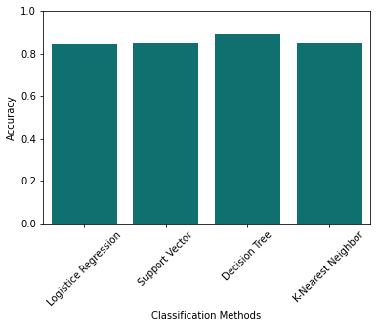
Classification Accuracy
Best Score accuracy is highest for Decision Tree which is 88.9%.
Testing Accuracy of all models is found to be equal.
Training Accuracy of SVM model is highest with 88%

Slide 46
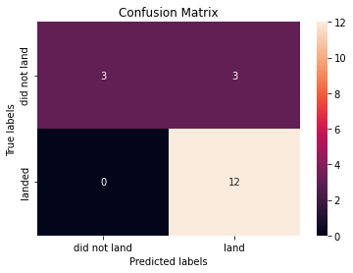
Confusion Matrix
Confusion Matrix of Decision Tree is shown below with some observations.
Out of 18 samples 12 times it was predicted successful land which actually landed.
3 time predicted landed however it did not landed.
3 times it was predicted did not land and it did not landed.

Slide 47
Conclusions
The Project help us understanding the correlation of outcome of Launch on various factors including site location, booster version, payload mass etc.
Site CCAFS SLC 40 is good option for payload mass greater than 14000kg, whereas site KSC LC 39A is better payload mass less than 5000kg.
Site KSC LC 39A is having the highest success ration among all the sites.
Booster version FT is better option for the Payload mass between 2000-5000 kg, whereas Booster version B4 is good fit for payload mass less 4000 kg.
The predictive model produced by decision tree algorithm performed the best among the 4 machine learning algorithms employed with 83% out of sample accuracy.

Slide 48


